Slide 1
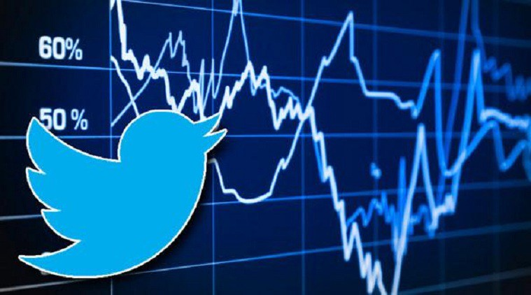
Twitter Content Sentiment Analysis to Predict Crypto Currency (Bitcoin) Movement
Members:
Kaushik, Sarthak
Liendo, Daniel
Patel, Tilisha
Yousuf, Muhammad Mehmood

Slide 2
Agenda
Motivation & Problem Statement
Introduction / Background
Tools Used
Assumptions, Data Mining and Data Processing
Classification Models
Conclusion
Challenges, Lessons Learned and Path Forward

Slide 3
Motivation & Project aim/objectives
Influence of Social media on stocks was quite visible for GME prices.
An announcement, opinion, or remark can be enough launch a news story or directly influence the market.
Hypothesis is that if a company has positive sentiment, it will lead its stock price to increase in the near future.
Problem: Use twitter information to derive the sentiments (positive, neutral or negative) and predict the direction of stock movement (increase or decrease) to inform the user about buy/sell recommendations.

Slide 4
Introduction/Background
Research suggests that news impacts stock market movement and indicates the possibility of market prediction.
Tweets usually contain hashtags and symbols that facilitate the search for relevant posts and easier to crawl
Tweets classification is to use them as a time series supposedly correlated to another time series from stock/Bitcoin data.
Notes:
Research shows that news affects stock market movement and indicates the possibility of predicting the market. Perform natural language processing (NLP)
approach to predict movement using tweets sentiment analysis. approach of identifying a small subset of influential Twitter accounts and analyzing their tweets with a variety of NLP techniques.
The most respected financial journals have Twitter feeds that follow the news, and often break it.
80% of institutional investors monitor social media during their workday.
The financial news network provides real-time business information to 355 million households worldwide per month. Its 14-hour live coverage is geared toward individual investors as well as trading professionals.8
The outlet's Twitter account has more than 4.3 million followers.9
More than 60% of U.S. adults get news on social media
Using Twitter as our news source allows us to get the most up to date news.

Slide 5
Tools / Libraries Used
Python
Octoparse for Tweets Scraping / Twitter API
Yahoo-finance
NLTK NLP library
SentimentIntensityAnalyzer function for Deriving Sentiments
Swifter
Scikitlearn
Keras

Slide 6
Assumptions
Stock market movement every 15 minutes frequency
Assumption that any news would impact within 15 minutes of the event.
With investors, it is now feasible for them to act within minutes of an event
Stock market is closed, the tweet was analyzed to impact as part of next day opening price
When the markets open they react to the information that has happened since the markets were closed
Tweets sentiments were averaged out during the 15 minutes
Used pretrained VADER NLTK sentiment analysis algorithm for sentiment analysis

Slide 7
Data Mining
TWEETS
Web Scraping technique
102,683 tweets
7 twitter accounts
Features
Tweet and the derived sentiment
~30k tweets after merging & data processing
STOCK
Yahoo finance API
Stocks / Market Indices / 1 Crypto (BTC)
15 minute interval could only be done for the last 60 days (limitation)
Label
Stock price
Derived stock direction (Increase or Decrease) label as Target
Notes:
@Elonmusk, @CNBC, @ReutersBiz, @business, @CNNPolitics, @BBCPolitics, @WSJ
NASDAQ, TSLA, S&P 500, Crude Oil, S&P/TSX, BTC-USD

Slide 8
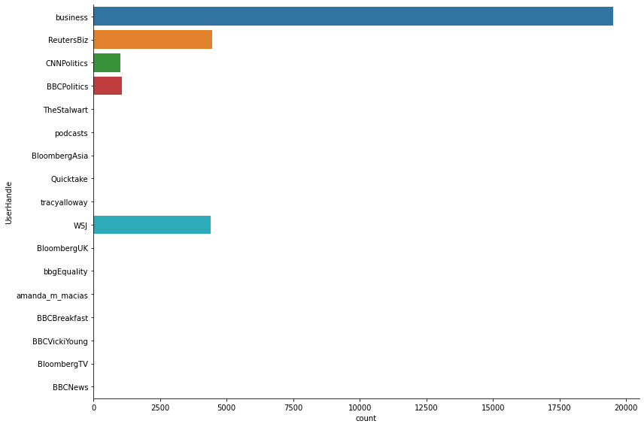
Tweet Sources (After Pre-processing)
Notes:
Business + politics news
No RTs. Only original tweets.

Slide 9

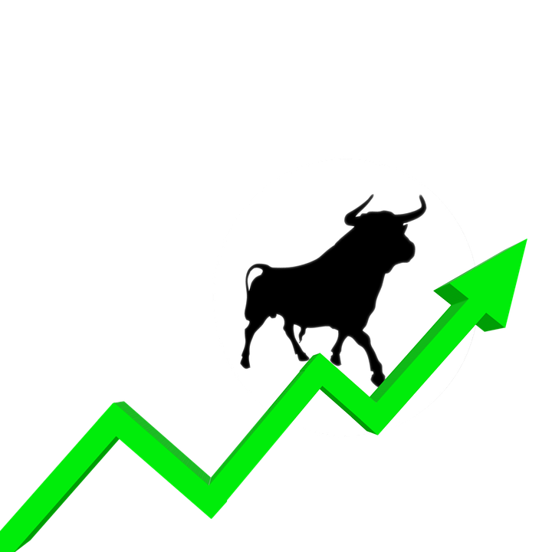
Data Processing Pipeline
Tweets
Collection
Data Transformations (Sentiment Mean per 15 mins)
Test Train Split
(75-25, shuffle=F)
Model Implementation
Classification
Model Evaluation
Data Processing
Sentiment
Analysis
NLP TFIDF/
BERT Tokenizer
Stock Market data
Collection
Data Processing
Stock Price
Analysis
Notes:
Two things - that we did

Slide 10
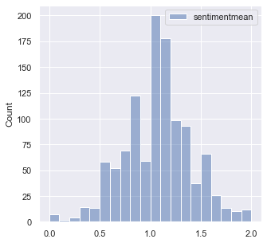
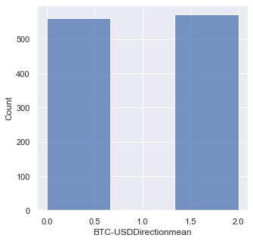
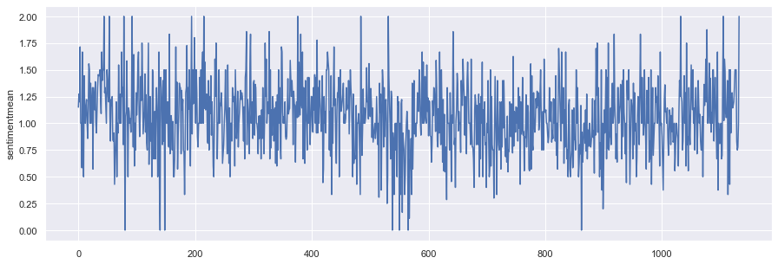
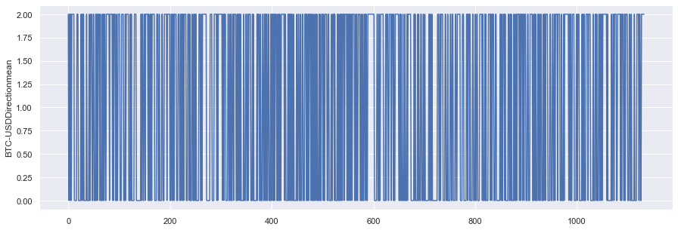
Exploratory Data Analysis (EDA)
Sentiment Histogram
Label Direction Histogram
Time-Series Change for Sentiment
Time-Series Change for Label

Slide 11
Classification Models Tuning Built on Sentiment Analysis
Classification Algorithm | Hyper Parameters
Decision Trees | 'criterion':['gini','entropy'], 'max_depth':[5,10,20]
Random Forest Classifier | 'criterion':['gini','entropy'], 'max_depth':[5,10,20], 'n_estimators':[10,20,100]
SVM Classifier Pipeline | Pipeline(steps=[("poly_features", PolynomialFeatures()),("svm_clf", SVC())]) param_grid = {'poly_features__degree':[1,2,3], 'svm_clf__C': [0.1, 1, 10, 100, 1000], 'svm_clf__gamma': [1, 0.1, 0.01, 0.001, 0.0001], 'svm_clf__degree':[1,2,3], 'svm_clf__kernel': ['linear','rbf','poly','sigmoid']}
Naive Bayes & Neural Network (using the tweet content) | No Hyper parameter tuning. (Future Work)

Slide 12
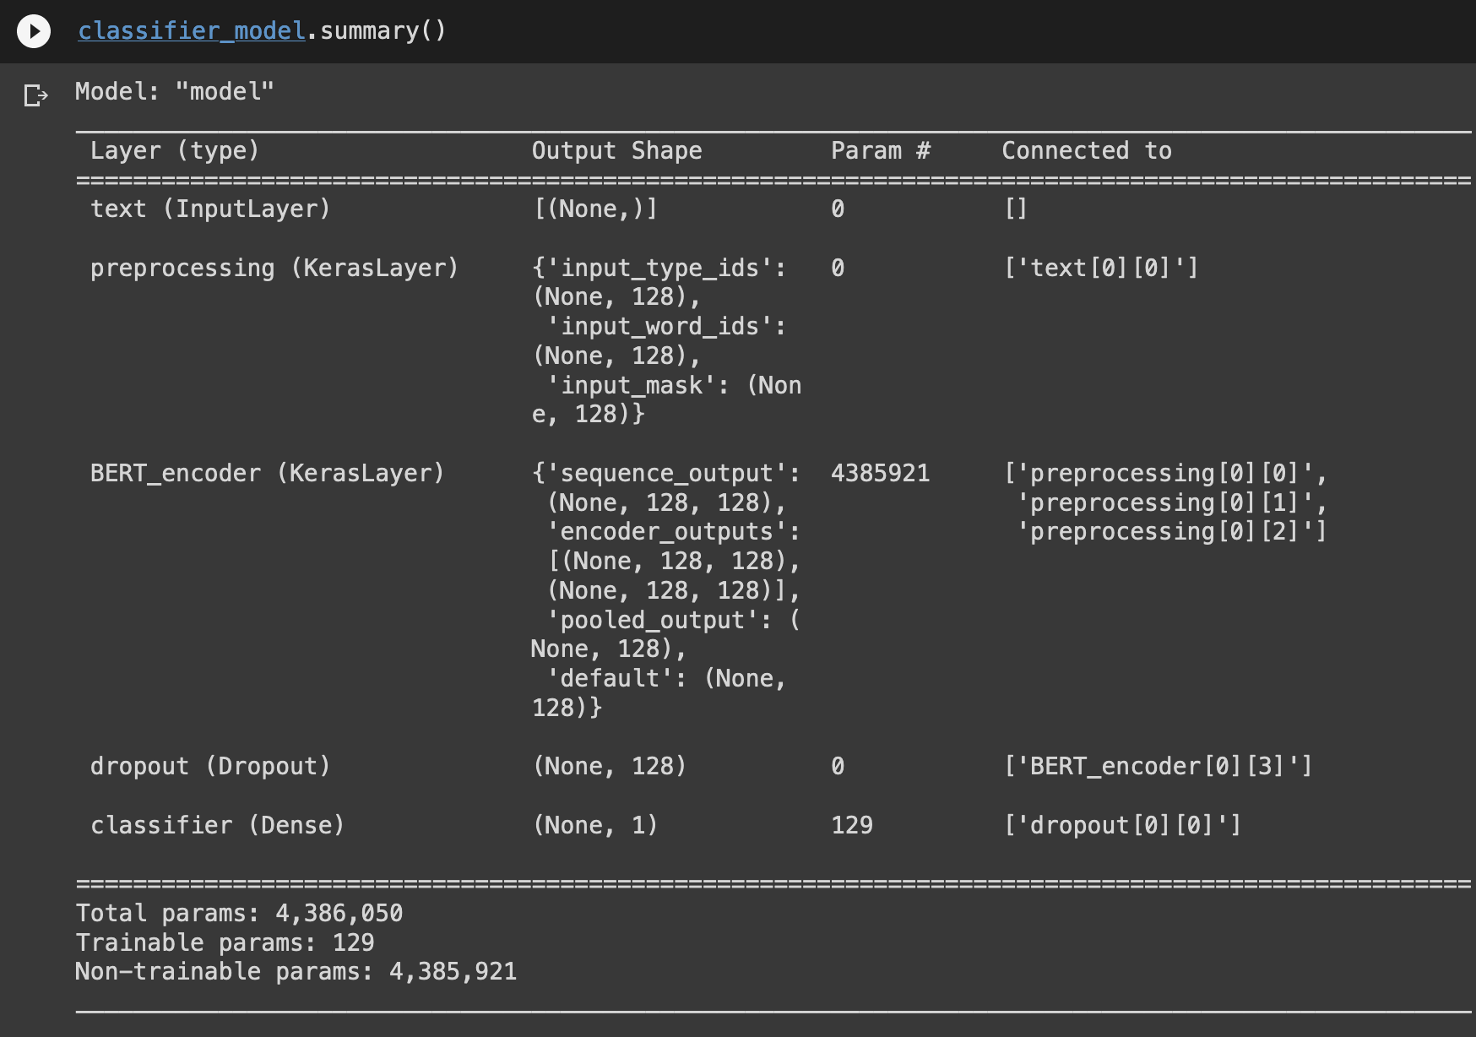
Classification Models Built on Tweet Text
Classification Algorithm | Hyper Parameters
Naive Bayes | Processed Tweets > CountVectorizer > TFIDF > Naive Bayes Estimator Evaluation
Neural Network (using BERT Embeddings & BERT Pretrained encoder) | Processed Tweets > BERT Preprocessing > BERT Encoding > Drop Out > Output Layer Loss= BinaryCrossentropy Metrics= BinaryAccuracy nEpochs=5

Slide 13
Classification Models Results
Classification Algorithm | Train Accuracy |  |  |  | Test Accuracy
 | Accuracy | Precision | Recall | F1-Score | Accuracy | Precision | Recall | F1-Score
Decision Trees | 64.19 | 63.64 | 64.85 | 64.24 | 47.89 | 50.70 | 48.00 | 49.32
Random Forest Classifier Pipeline | 58.66 | 59.94 | 50.12 | 54.59 | 49.3 | 52.59 | 40.67 | 45.86
SVM (Best Model) | 53.00 | 52.44 | 56.06 | 54.19 | 52.82 | 55.56 | 53.33 | 54.42
Naive Bayes (using the tweet content) | 74.41 | 69.69 | 95.91 | 80.72 | 44.76 | 42.83 | 85.26 | 57.02
Neural Network BERT Tokenizer (using the tweet content) | 45.85 |  |  |  | 55.20

Slide 14
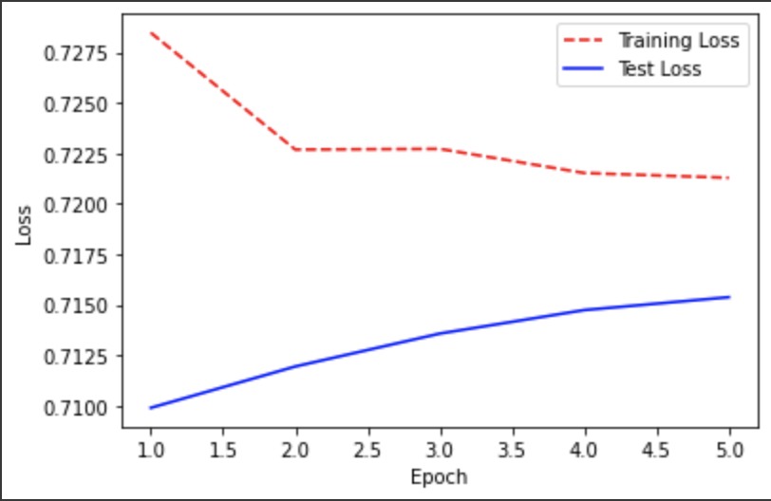
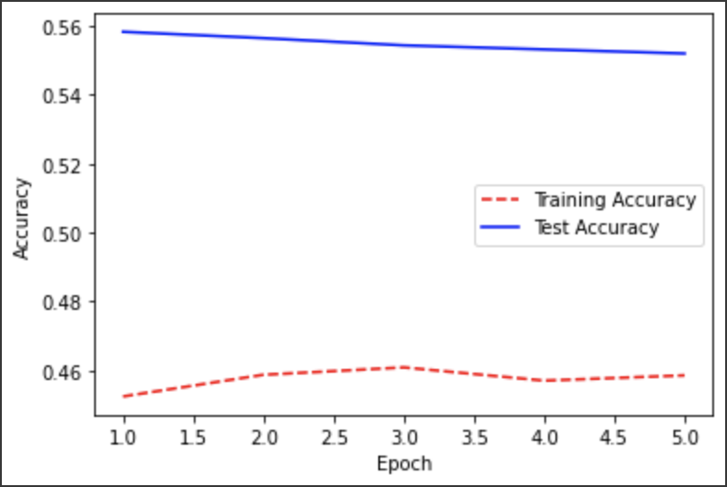
Neural Network BERT Tokenizer
Loss Per Epoch
Accuracy per Epoch

Slide 15
Discussion & Conclusion
Two ways of predicting cryptocurrency movements in 15 minute interval is implemented successfully.
Sentiment Analysis is not conclusive in prediction of stock movement. Perhaps inclusion of other features like tweet likes etc. may be evaluated as features
Analysis of direct tweet content is also not conclusive in prediction of stock movement.
The twitter handles must be handpicked to study the impact of a particular index, commodity, cryptocurrency.
The stock data also limits how much information can be used as initial dataset.
Perhaps the assumption that the information from social media is able to impact the markets within 15 minutes is not correct.
Notes:
What we interpret from the results?
There was no pattern that the machine learning algorithm could be applied.

Slide 16
Challenges During Execution
Data Mining
Struggle with yahoo finance API, limits on getting frequent market quotes beyond 60 days
Struggle with Twitter API, had to use Web scraping tool
Quality of Data
Twitter stock data has a lot of noise (stickers, ads, redirection urls, memes etc.)
Misclassification of sentiment because of noise
Data Transformation
Combining the data for twitter/stocks
Notes:
Number of tweets that we can get in one go, limitations on what can searched “$TSLA”
Duplication of tweets
Academic access required for decent data collection on twitter API

Slide 17
Lesson Learned & Path Forward
Lessons Learned
Make sure you have easy access to the data you need and a data strategy in place.
Proof of Concept Model
Path Forward
More research on userhandles and the commodity that needs to be predicted to ensure relevant information is gathered.
Data gathering of 15-minute stock data over a long period of time.
Expand the data by including other social media platforms like reddit, discord etc.
Ensemble Model - Voting Classifier

Slide 18

THANK YOU!

